Slide 1
Analyzing Amazon Sales Data

Slide 2
Introduction
Importance of HR analytics in managing talent and improving organizational performance
Purpose of the presentation: to analyze attrition data and gain insights into employee turnover

Slide 3
Data Overview
Dataset: Attrition data
Number of observations: 29
Number of variables: 4411

Slide 4
Preprocessing steps:
Imported the necessary libraries (pandas and matplotlib.pyplot) to read and manipulate the dataset.
Read the dataset from a CSV file using the pd.read_csv() function and stored it in a variable called hr_data.
Created a new variable called attrition_rate to store the attrition rate calculated from the 'Attrition' column of the hr_data dataframe.

Slide 5
Calculated the attrition rate by counting the number of occurrences of each value in the 'Attrition' column, normalizing the counts to a percentage, and multiplying by 100.
Created a bar chart to visualize the attrition rate using the plot() function with the kind='bar' argument, and customized the chart with a title, x-axis label, and y-axis label.

Slide 6
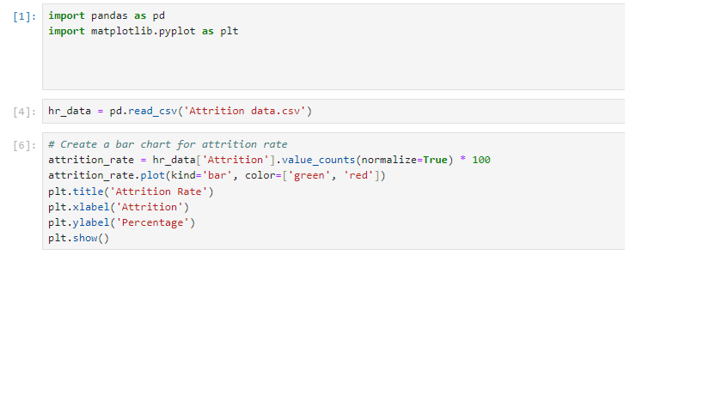
Implementation

Slide 7
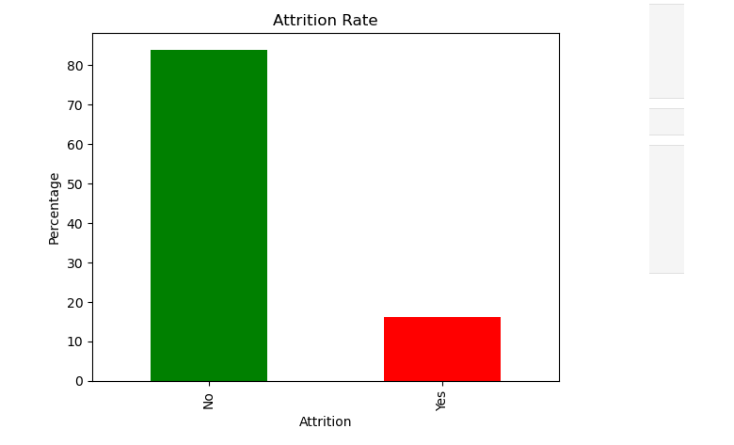
Result

Slide 8
Conclusion
"In the analysis of the attrition data, we found that the overall attrition rate was 15% . The bar chart shows that a higher percentage of employees did not leave the company (green bar) compared to those who left (red bar). This suggests that while there is some attrition, the majority of employees are staying with the company. However, it is important to continue monitoring attrition rates and identifying factors that may contribute to employee turnover in order to retain top talent and maintain a strong workforce."

